Slide 1


Business Problem 6 – Finding the Gems
Powered by Stay Ahead
We Build Network!!!

Slide 2

Business Problem:
You have been approached by a Venture Capital Fund. The Board of Directors are currently reviewing 1000 potential interesting startups and deciding on which ones they are going to invest in.
The criterion for selecting investments for this fund is a combination of
High Revenue (2015)
Low Expenses (2015)
Top Growth (2015)
Your task is to assist the Board in identifying which business represent the best investment opportunities.
What we will learn today
What are groups?
What are sets?
Static sets
Dynamic sets
Combined sets
Controlling sets with parameter

Slide 3
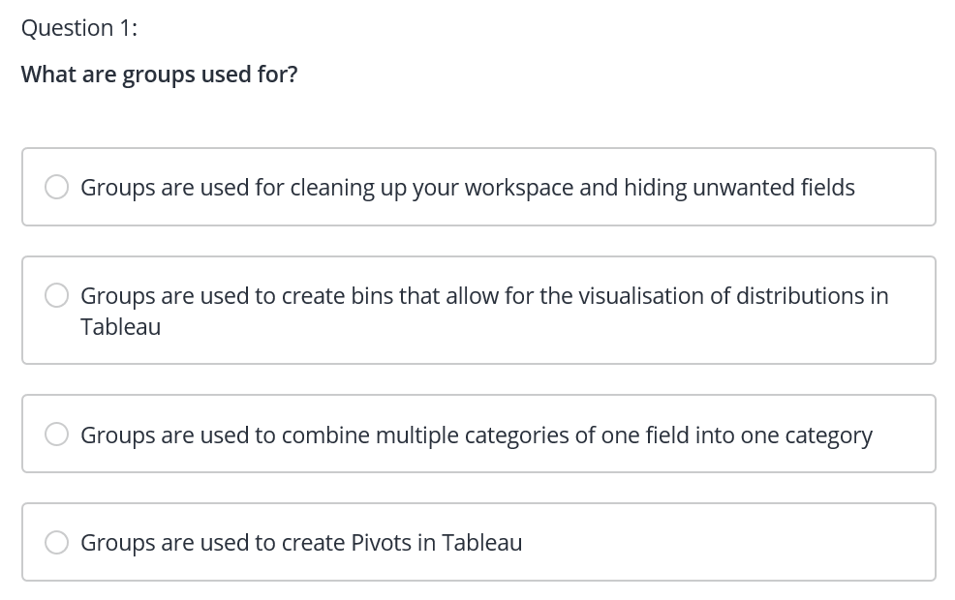

Slide 4
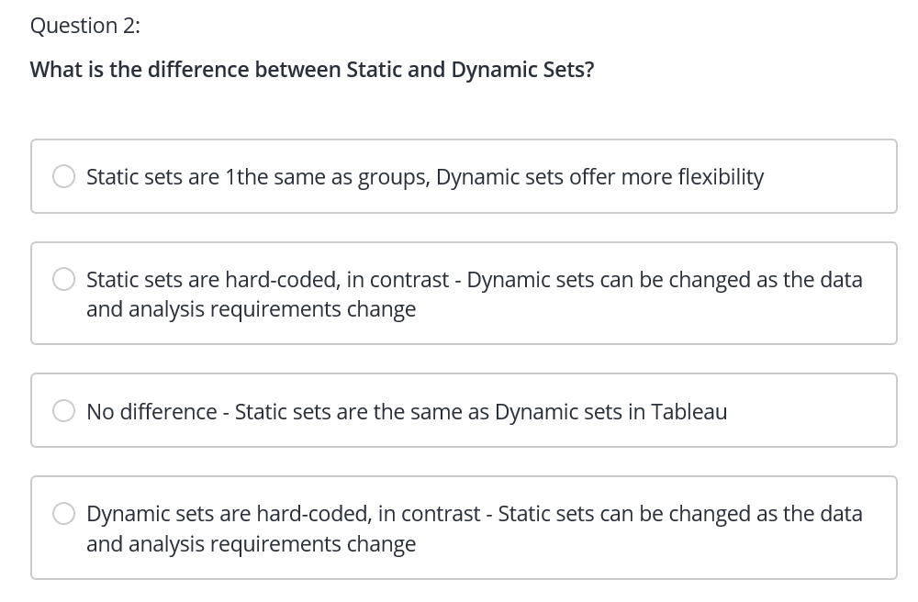

Slide 5
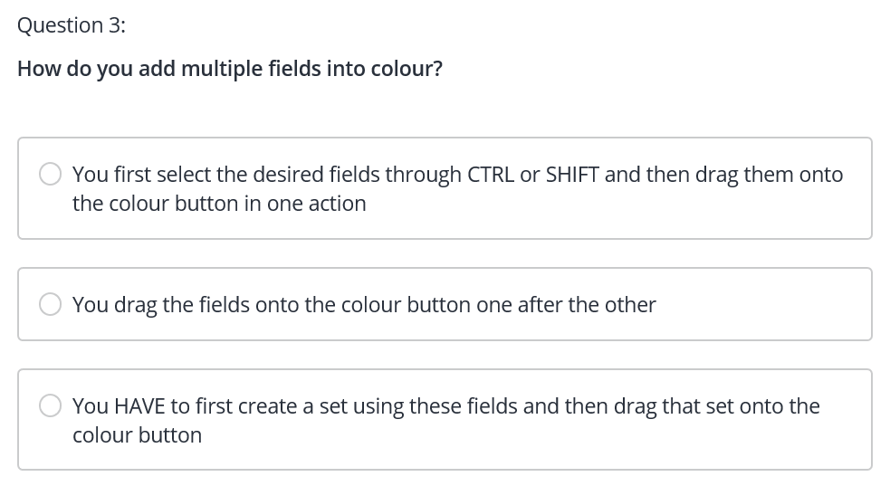

Slide 6
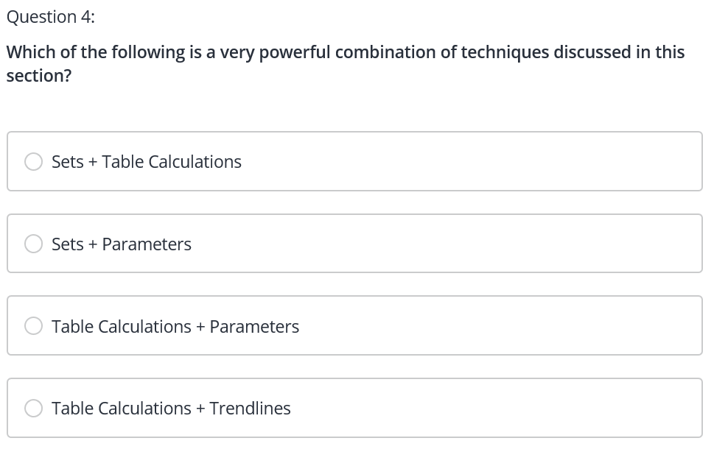

Slide 7
